Slide 1
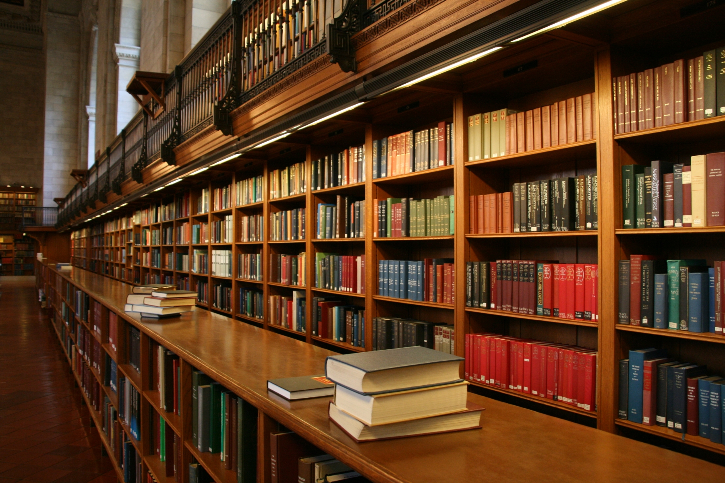
Search inside library
Subtitle

Slide 2

The Problem
Finding a Book
Tedious manual work and time-consuming
Managing books
Searching books
Often not fruitful
What if books are missing or misplaced?

Slide 3

The Problem
Building Book Inventories
How can a person automatically generate an inventory of all the books he has, without going through the tedious process?
How can we generate an inventory of all the books currently on the bookshelves in a library, in an efﬁcient manner?
Notes:
How can a person automatically generate an inventory of all the books he/she has in the home or ofﬁce, without going through the tedious process of typing in the title, authors, publisher, and edition of each book into a computer?

Slide 4
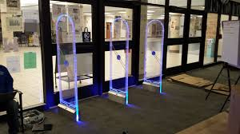
Solution ?
Manual creation of the inventory
Very costly in terms of human labour
Error-prone.
A barcode or radio-frequency identiﬁcation (RFID)
Very expensive
Requires physically attaching a marker to each book.
Need a more cost-effective and convenient method for building inventory and searching book.

Slide 5
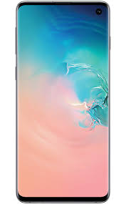

Solution ?
Modern smartphones are becoming ubiquitous, and these phones are equipped with high-resolution cameras, various location sensors, and access to high-speed networks like Wi-Fi.
Recently, deep neural models, such as Convolutional Neural Networks (CNN) and Recurrent Neural Networks (RNN) have achieved great success for scene text detection and recognition.

Slide 6
Our Purpose
The intent is to make what was previously a tedious experience (i.e., searching books in bookshelves) much more user-friendly.
Design and implement a mobile book recognition system for conveniently generating an inventory of books and searching books by snapping photos of a bookshelf with a smartphone.
Implement a cost-effective system using smartphones.

Slide 7
Goals
Help users quickly locate the book they are looking for.
Build a book inventory from only the images of bookshelves

Slide 8
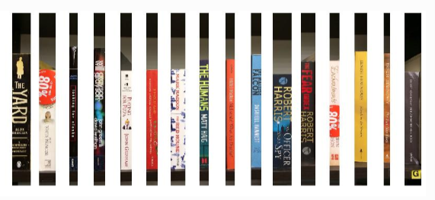
Book Spine Segmentation
Identify the borders of each individual spine
Separate them in preparation for further processing of each spine.
Often books are densely packed together !

Slide 9
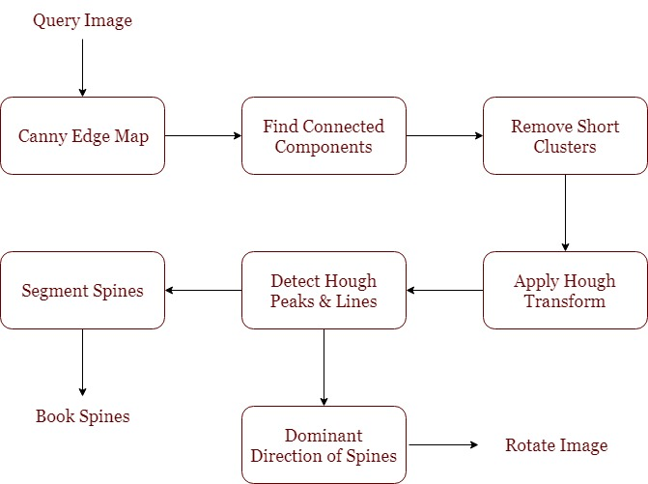
Book Spine Segmentation

Slide 10
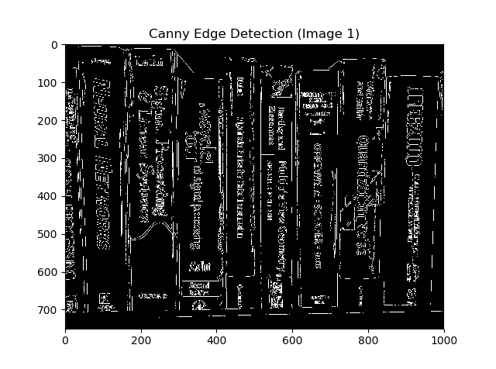
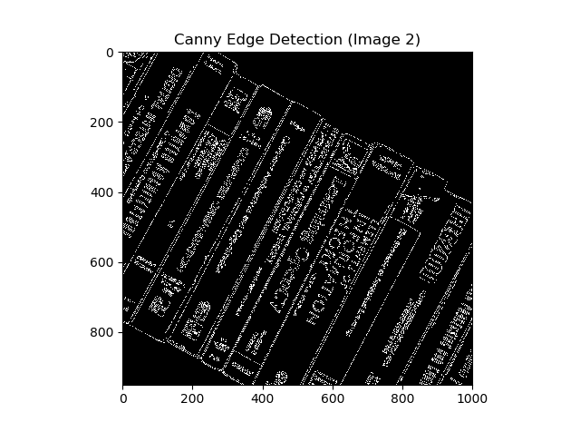
Book Spine Segmentation

Slide 11
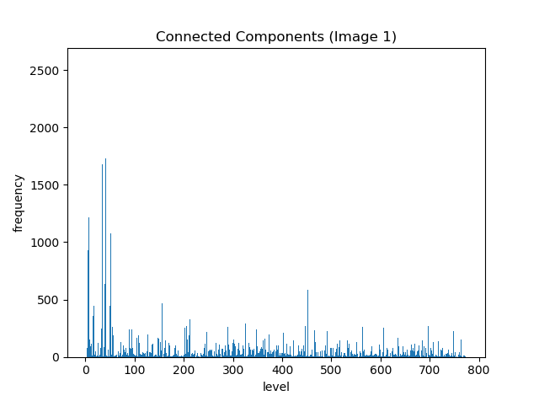
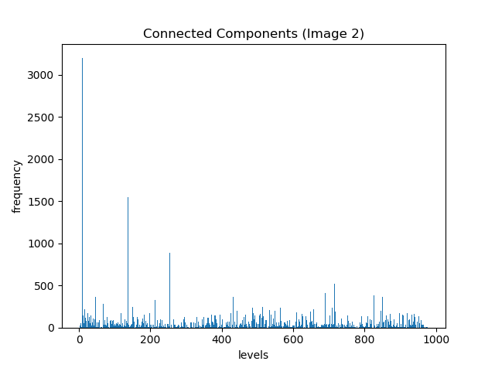
Book Spine Segmentation

Slide 12
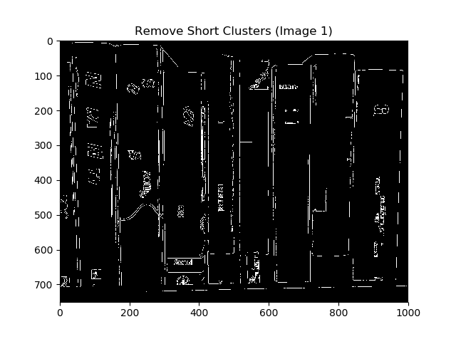
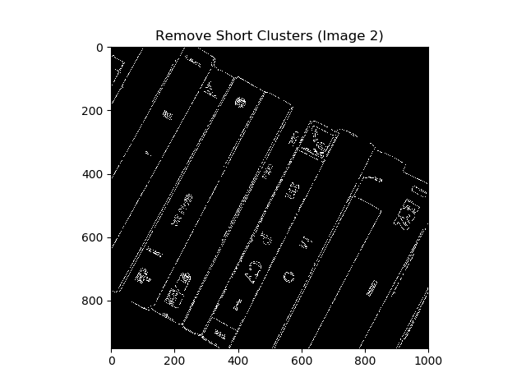
Book Spine Segmentation

Slide 13
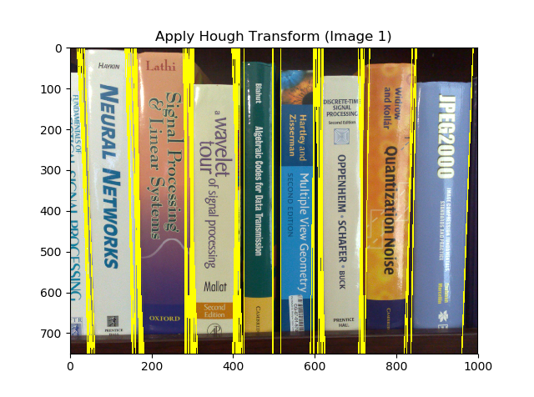
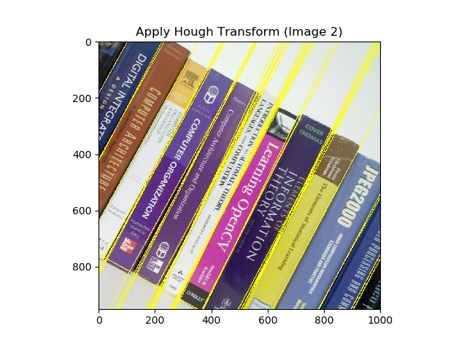
Book Spine Segmentation

Slide 14
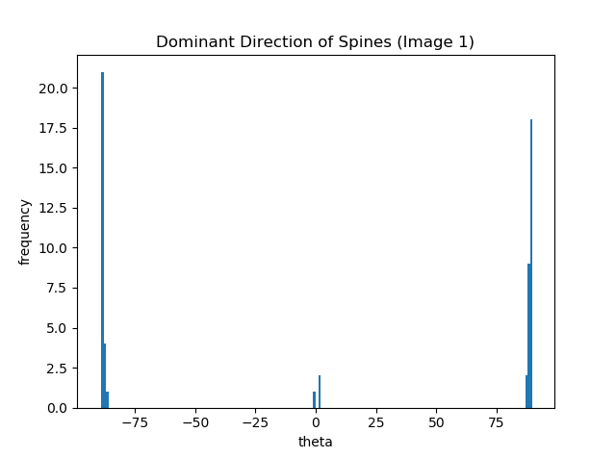
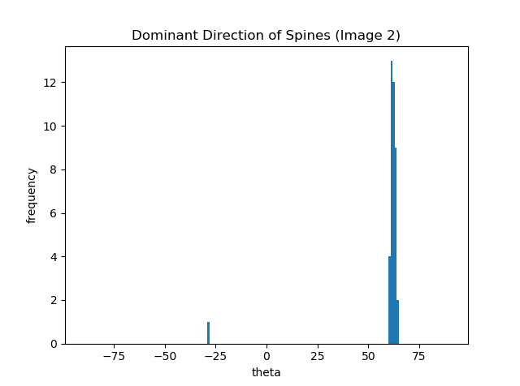
Book Spine Segmentation

Slide 15
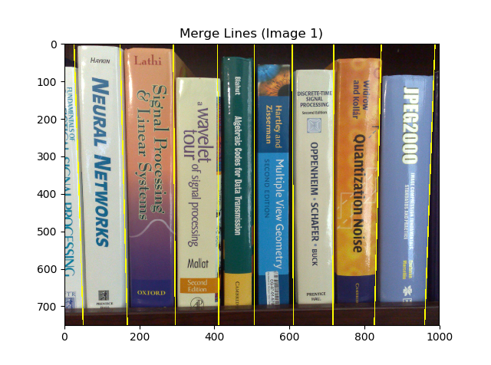
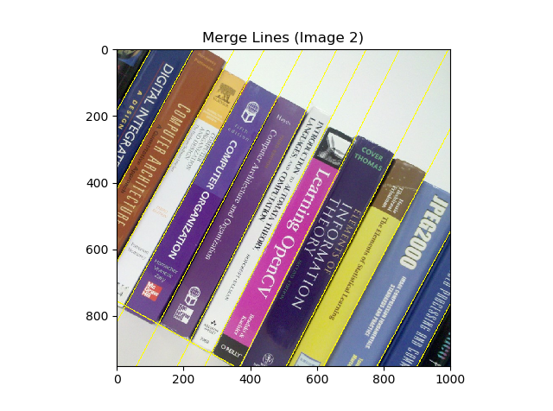
Book Spine Segmentation

Slide 16








Book Spine Segmentation

Slide 17
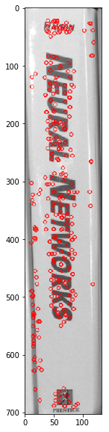
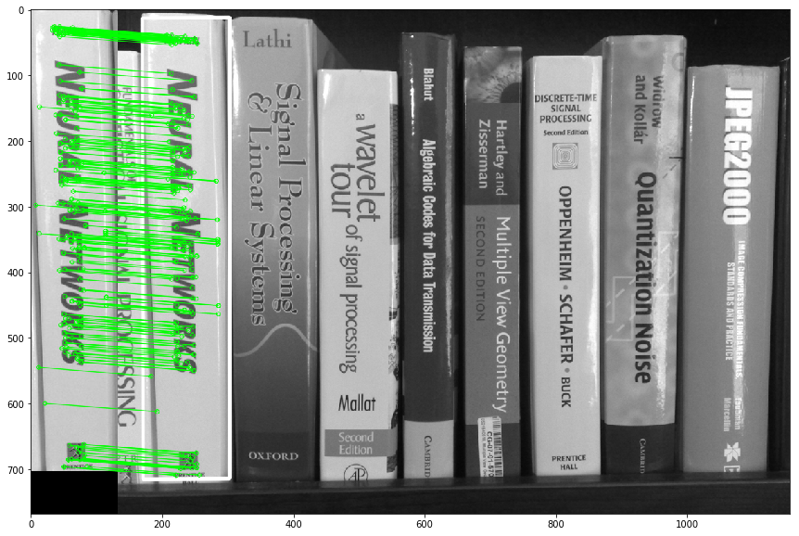
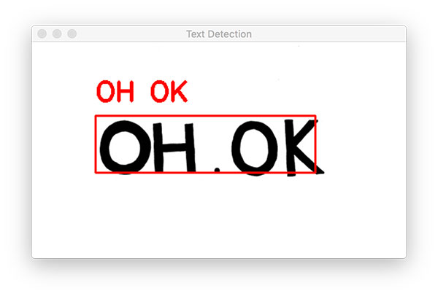
Book Retrieval
Two approaches –
Image feature-based recognition pipeline
Text-based recognition pipeline

Slide 18
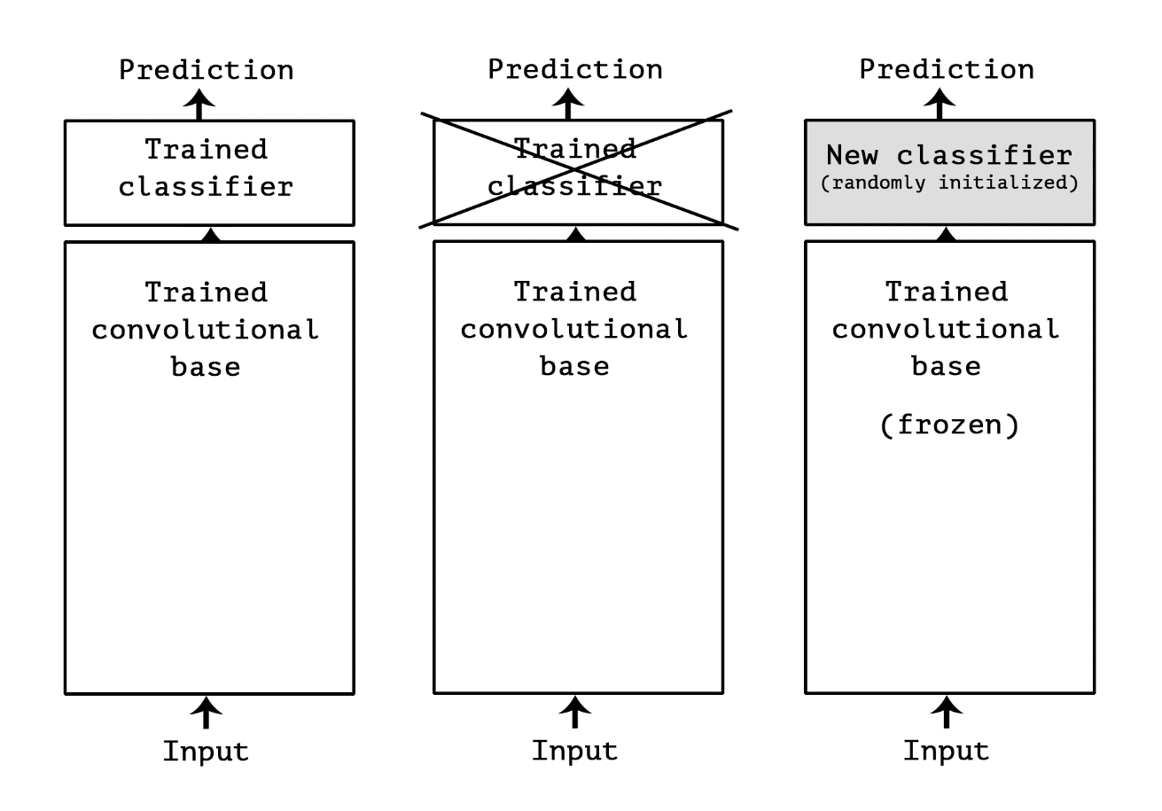
Image Feature-based Retrieval
Feature extraction consists of using the representations learned by a network to extract features from new samples.
Convnets used for image classification comprise two parts:
Convolutional base
Classifier

Slide 19

Using a Pre-trained model
VGG16 Architecture (ref)

Slide 20
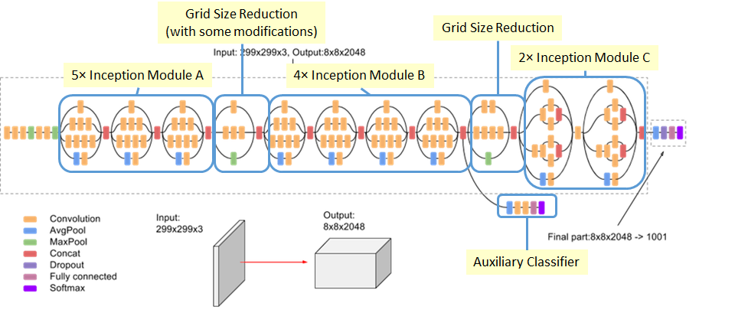
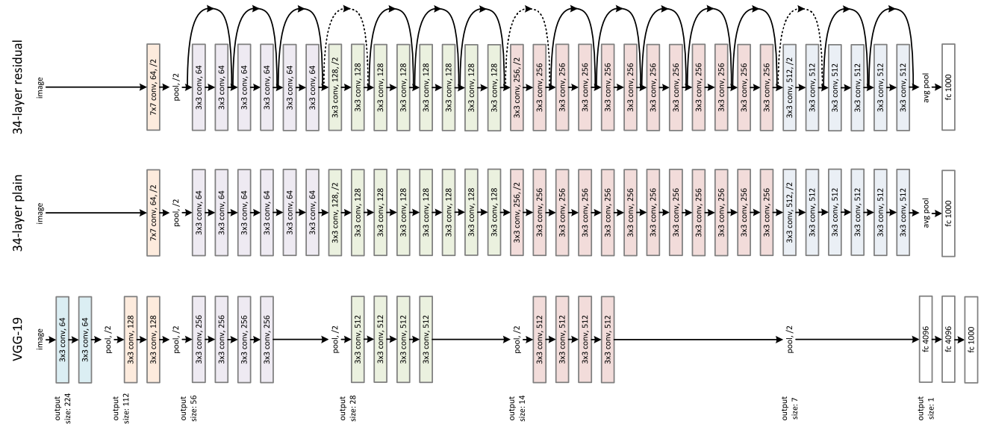
Using a Pre-trained model
InceptionV3
ResNet50
VGG16
VGG19

Slide 21
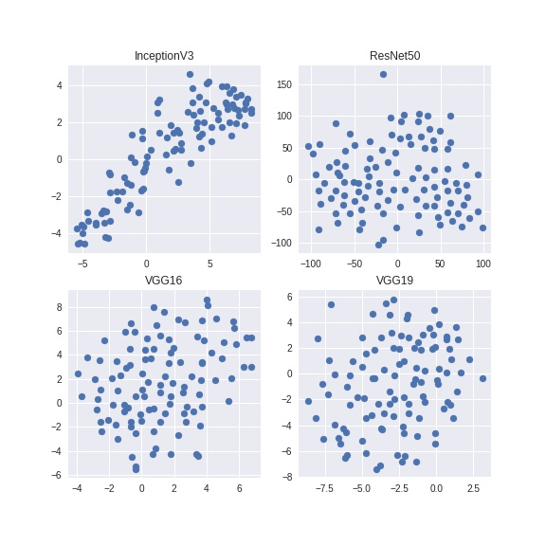
Dimensionality Reduction
Extract the features using different deep learning models.
Apply dimensionality reduction technique PCA
Reduce number of items in feature vector (dimensions) down to 2.
Visualise the relationships between each vector using a scatter plot
Are there any similar images ?

Slide 22
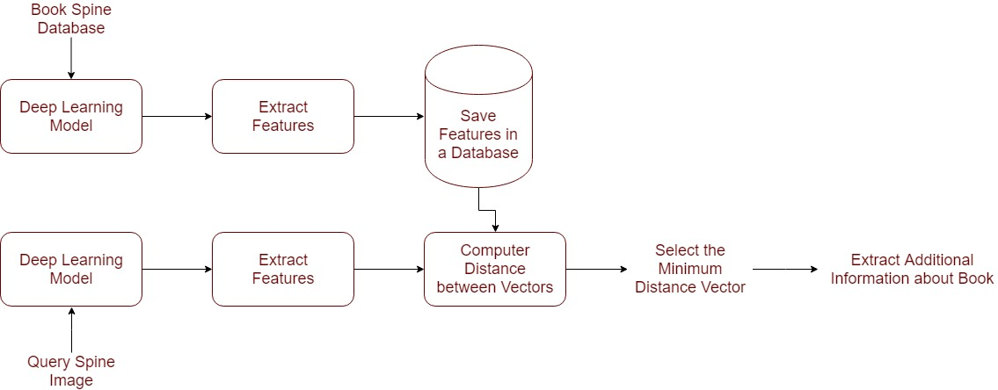
Image Feature-based Retrieval

Slide 23
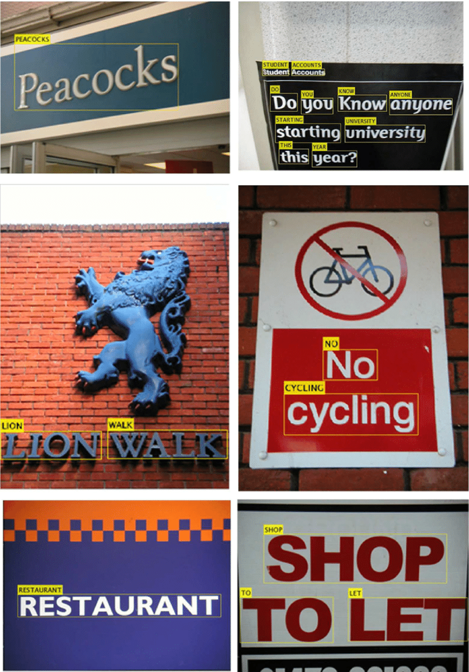
Text-based Retrieval
Text Localization
Detecting text in images of library bookshelves.
Text Recognition
OCR based approach
Convolutional and recurrent neural architectures

Slide 24
Text Localization
Detecting text in constrained, controlled environments
Use heuristic-based approaches
Text is typically grouped into paragraphs
Characters appear on a straight line
Natural scene text detection is different and much more challenging.
What assumptions we can and cannot make ?

Slide 25
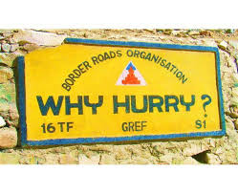
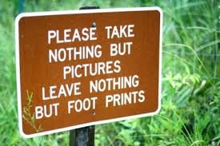
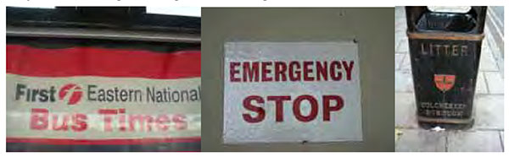
Why is natural scene text detection so challenging?
Image/sensor noise
Viewing angles
Blurring
Lighting conditions
Resolution
Non-paper objects
Non-planar objects
Unknown layout

Slide 26
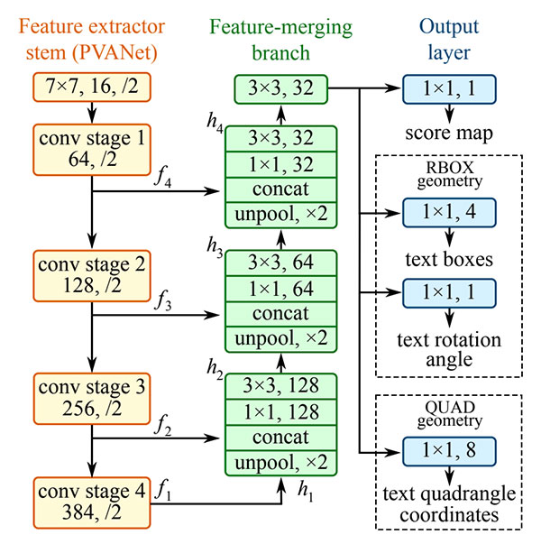
The EAST deep learning text detector
Efficient and Accurate Scene Text detection pipeline

Slide 27
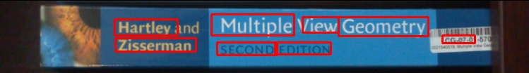
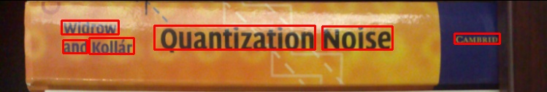



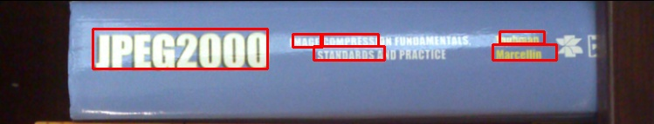
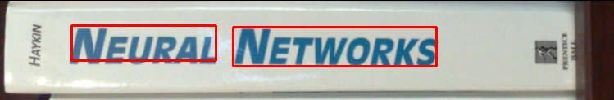
Text Detection Results

Slide 28
Text Recognition
Book spine images are identiﬁed based on the recognized text
Used as keywords for indexing or searching a book database.
Only relies on text information without requiring the original spine images.

Slide 29
Text Recognition via Sequence Labeling
Segmenting and recognizing each character is highly sensitive to various distortions in images, making character level segmentation imperfect and sometimes even impossible.
So train a model to recognize a sequence of characters simultaneously.
Adopt a hybrid approach that combines a CNN with an RNN, casting scene text recognition problem as a sequential labeling task.
A CNN learns features from the images which are then composed as feature sequences that are subsequently fed into an RNN for sequential labeling.
A bidirectional Long Short-Term Memory (B-LSTM) model is applied on top of the learned sequential CNN features to exploit the interdependence among features.

Slide 30
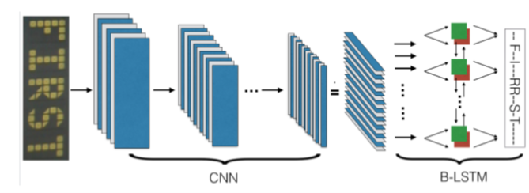
Text Recognition via Sequence Labeling
"FIRST"
Sequences X (prediction) and Y (target) have diﬀerent lengths, so adopt CTC loss to allow an RNN to be trained for sequence labeling task without exact alignment.
CTC loss is the negative log likelihood of outputting a target word Y given an input sequence X.

Slide 31

Tesseract OCR
Tesseract (v4) supports deep learning-based OCR that is significantly more accurate.
The underlying OCR engine itself utilizes a Long Short-Term Memory (LSTM) network, a kind of Recurrent Neural Network (RNN).

Slide 32
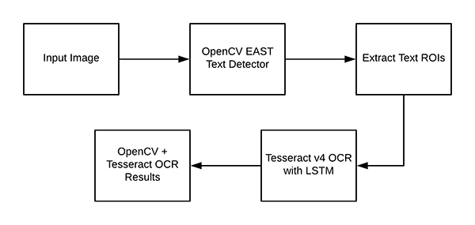
Tesseract OCR Pipeline

Slide 33

Limitations and Drawbacks
Expecting 100% accurate Optical Character Recognition is simply unrealistic.
Text recognition pipeline can fail if:
The text is skewed/rotated.
The font of the text itself is not similar to what the Tesseract model was trained on.
Tesseract assumes that your input image/ROI has been relatively cleaned.

Slide 34





Text Searching
Tokens:
{ haste, tibshirani,
friedman, the,
elements, statistical,
Learning }
Match Information:
{ Title: The Elements of Statistical Learning,
Authors: [Friedman, Tibshirani, and Hastie]
Publishers: [Springer] }
Notes:
with the grouped tokens in hand I used a combination of some web scraping and calls to the amazon Product Advertising API to obtain...
..a potential book match, consisting of the book’s title, authors, and publishers, as well as the book’s price information on the Amazon used books marketplace.

Slide 35
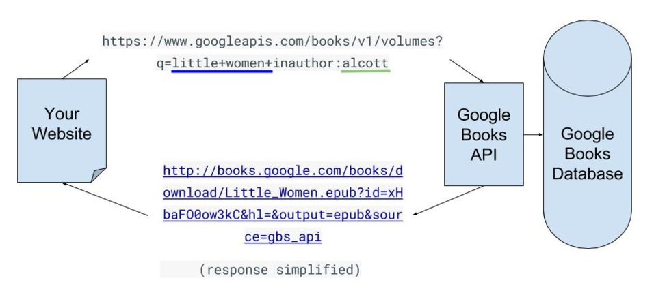
Searching Text
Use online books databases –
Amazon product API
Google Books API
Goodreads API
Use nearest neighbor word matching and tf-idf (term frequency-inverse document frequency) weights to rank returned results.

Slide 36
Evaluating Retrieval Performance
Calculate
Precision - Proportion of correctly identiﬁed books to the declared correct books,
Recall - Proportion of correctly identiﬁed books to all queries
Also, evaluate the spine segmentation performance.

Slide 37
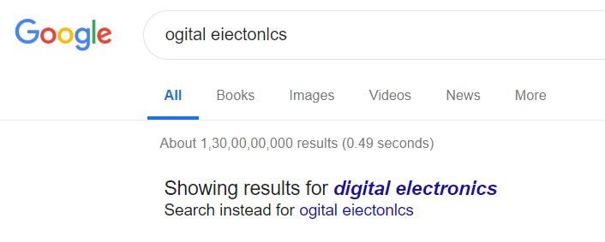
Need More Accuracy ?
Use text correction
Train another RNN model
Use google search engine for correcting text
Combine the results:
Text-based recognition pipeline
Image feature-based recognition pipeline
Time consuming

Slide 38
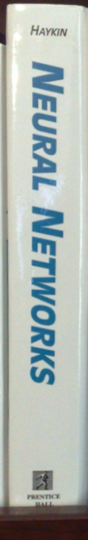


Deciding Book/Text Orientation
Assuming this
What about this ?

Slide 39
Other tasks
Developing Android app
Estimating location using sensors in smartphones.

Slide 40
Template Matching

Slide 41
Using SURF Features

Slide 42

thank
uou

